Slide 1

NBA All-Star Analysis
By: Jason Louwagie The University of Texas at San Antonio DA 6813 December 5, 2021

Slide 2


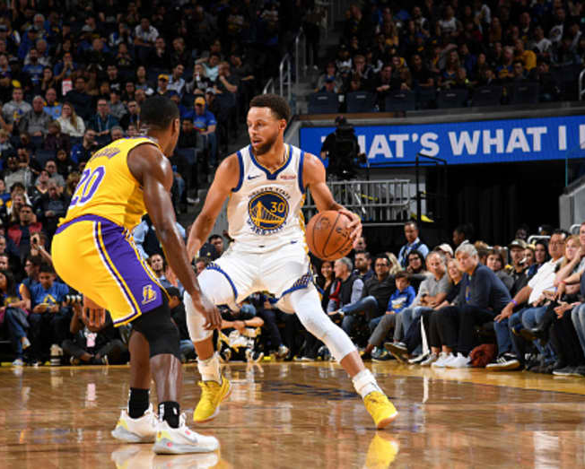
Background
NBA is projected to generate $10 billion in revenue in the next year
Concerns of decline in viewership
Covid-19 Pandemic
Reformatted All-Star Game
Player incentives to be named an All-Star
Conditional benefits for players
Increased quality of performance

Slide 3

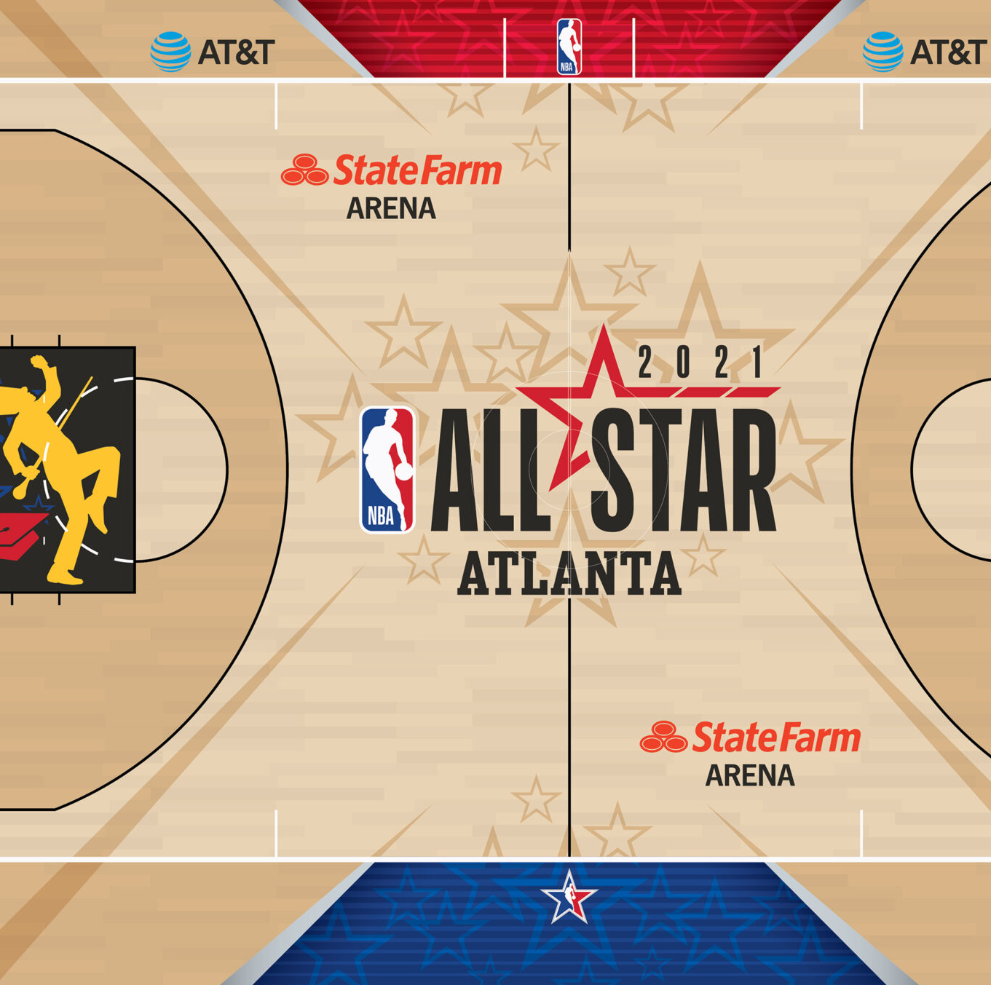
Motivation
How can players and teams understand what to look for in determining a higher likelihood of becoming an All-Star
Players: What?
NBA Franchises: Who?
Can players use All-Star skills and career potential as leverage for higher pay?
Can franchises identify overlooked players and sign them at a lower rate?

Slide 4
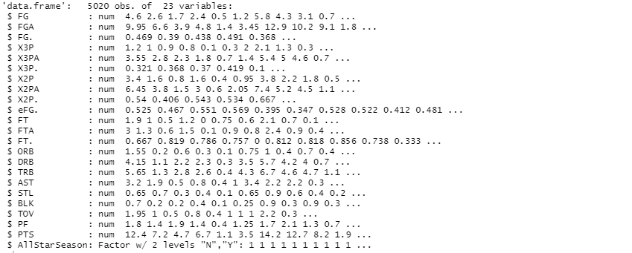
The Data
Obtained all player and Allstar game stats from the 2011-2012 to 2020-2021 season
Table were joined by Player and Season and cleaned using tidry and dplyr packages in R
FG -- Field Goals Per Game
FGA -- Field Goal Attempts Per Game
FG. -- Field Goal Percentage
X3P -- 3-Point Field Goals Per Game
X3PA -- 3-Point Field Goal Attempts Per Game
X3P. -- 3-Point Field Goal Percentage
X2P -- 2-Point Field Goals Per Game
X2PA -- 2-Point Field Goal Attempts Per Game
X2P. -- 2-Point Field Goal Percentage
eFG. -- Effective Field Goal Percentage This statistic adjusts for the fact that a 3-point field goal is worth one more point than a 2-point field goal.
FT -- Free Throws Per Game
FTA -- Free Throw Attempts Per Game
FT. -- Free Throw Percentage
ORB -- Offensive Rebounds Per Game
DRB -- Defensive Rebounds Per Game
TRB -- Total Rebounds Per Game
AST -- Assists Per Game
STL -- Steals Per Game
BLK -- Blocks Per Game
TOV -- Turnovers Per Game
PF -- Personal Fouls Per Game
PTS -- Points Per Game
AllStarSeason – Whether the player was named an All-Star during the season

Slide 5

Analysis Techniques
Exploratory
Correlation Plots
Histograms
Boxplots
Inferential
Logistic Regression
K-Nearest Neighbors
Random Forest
Decision Tree

Slide 6
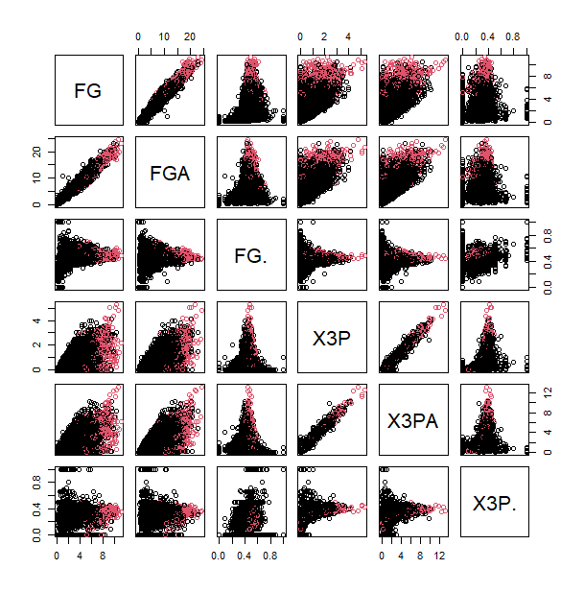
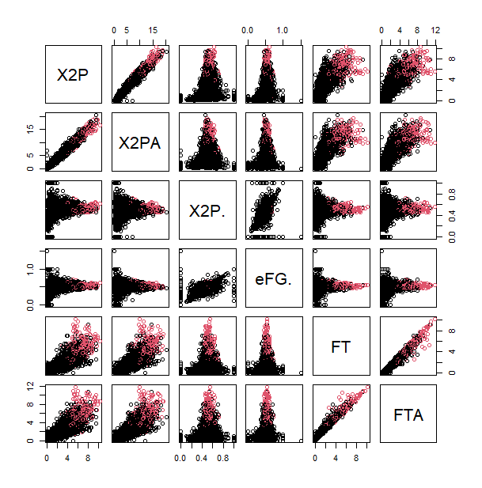
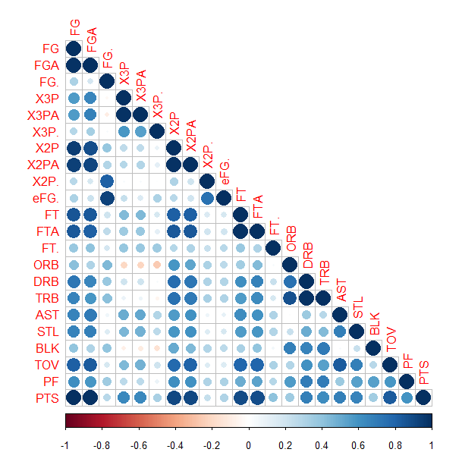
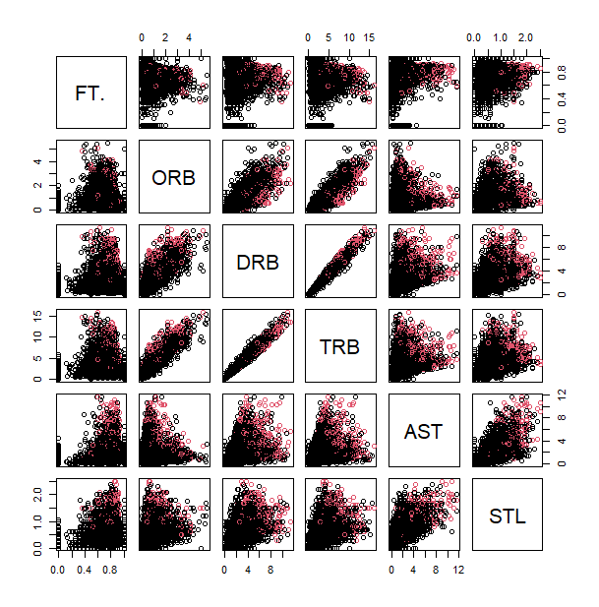
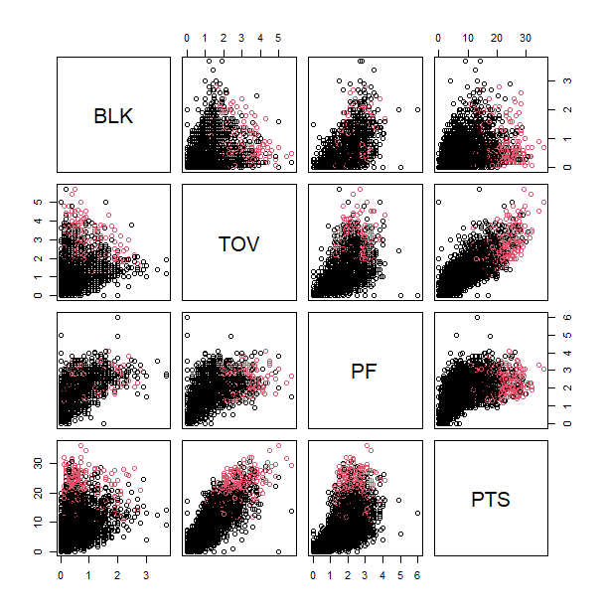
Exploratory Data Analysis

Slide 7
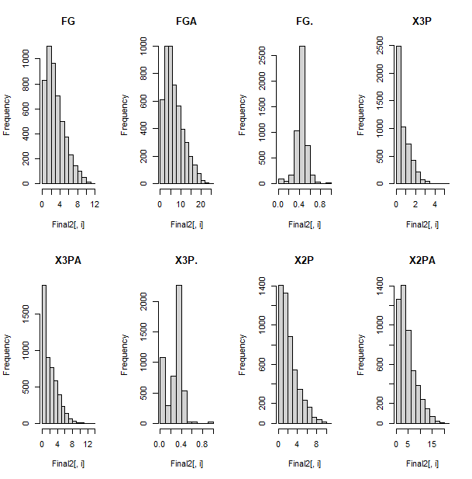
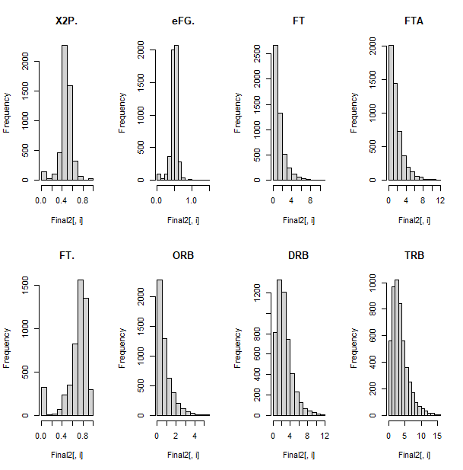
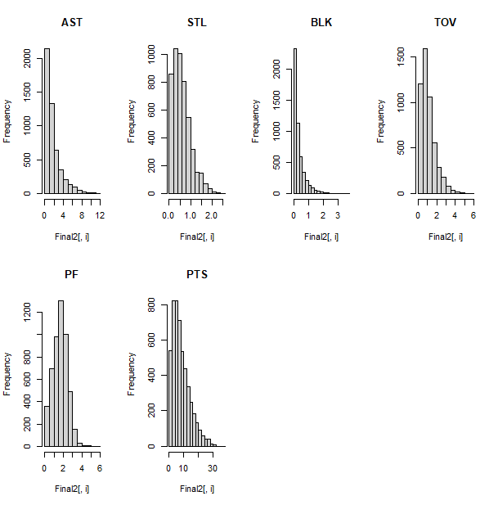
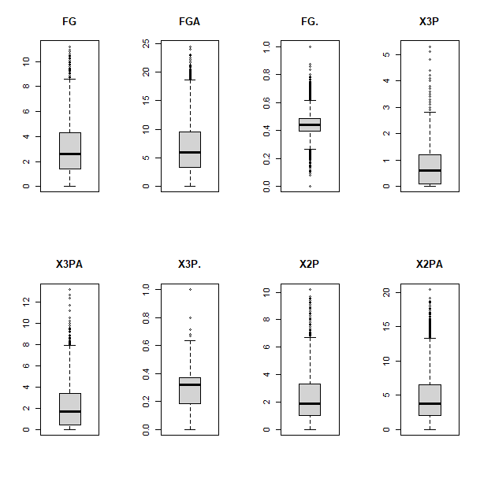
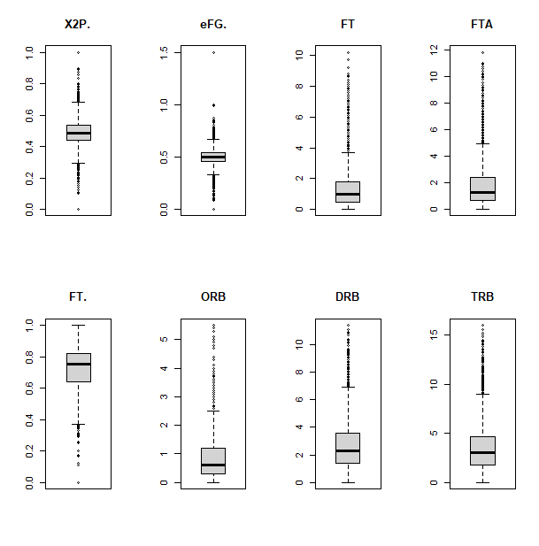
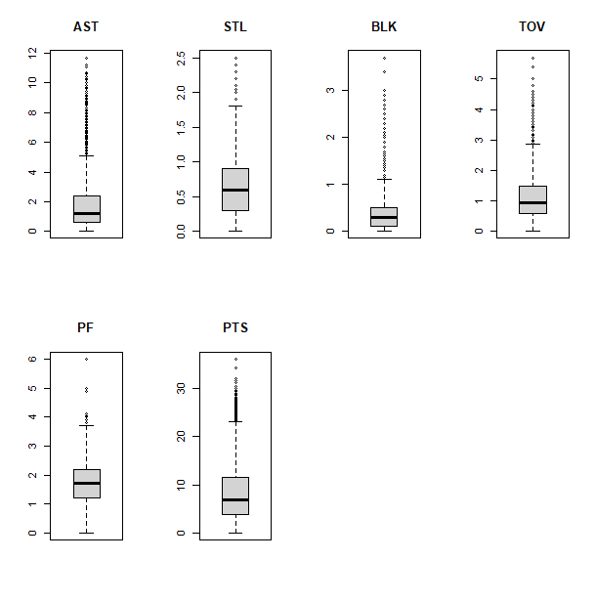
Exploratory Data Analysis cont.

Slide 8
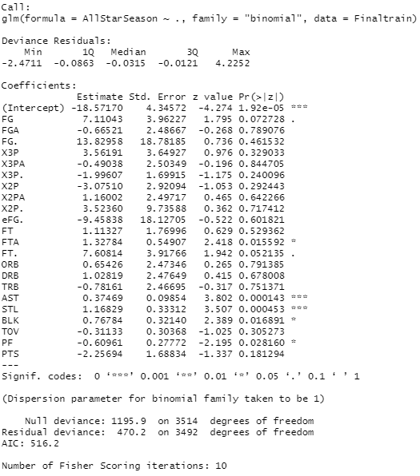
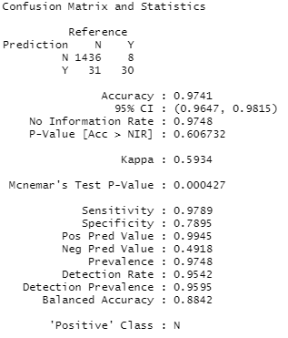
Logistic Regression
Accuracy: 97.41%
Sensitivity: 97.89%
Specificity: 78.95%

Slide 9
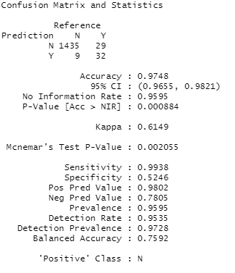
K-Nearest Neighbors
Accuracy: 97.48%
Sensitivity: 99.38%
Specificity: 52.46%

Slide 10
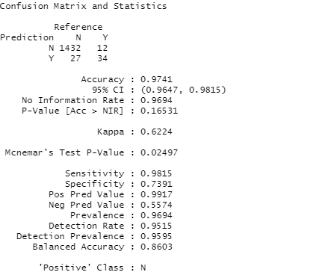
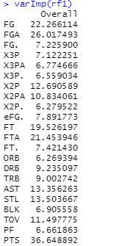
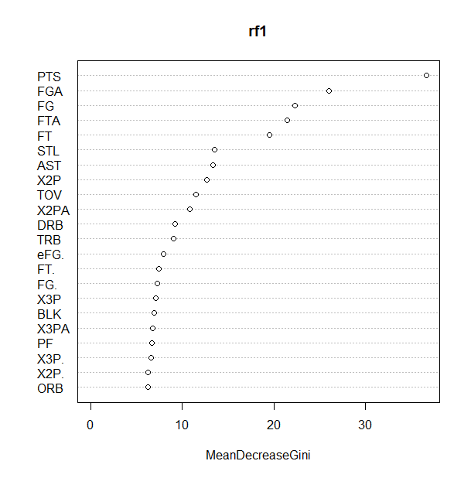
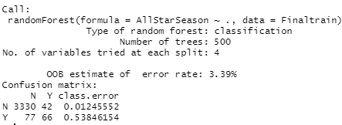
Random Forest
Accuracy: 97.41%
Sensitivity: 98.15%
Specificity: 73.91%

Slide 11
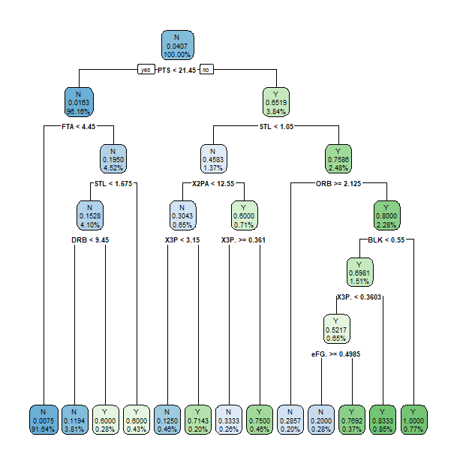
Decision Tree

Slide 12
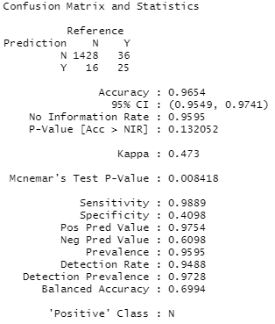
Decision Tree cont.
Accuracy: 96.54%
Sensitivity: 98.89%
Specificity: 40.98%

Slide 13
Conclusions & Recommendations
NBA Owners should utilize a KNN model to identify which players have the potential to be named an All-Star in the future
NBA Owners should focus on players that were falsely labeled as All-Stars to identify players on the rise
NBA Players should reference the decision tree and random forest to identify which skills they need to focus on compared to their current level.
Model | Accuracy | Sensitivity | Specificity
Logistic | .9741 | .9789 | .7895
KNN | .9748 | .9938 | .5246
RF | .9741 | .9815 | .7391
Decision Tree | .9654 | .9889 | .4098

